Slide 1

Classifying Severity of Colorectal Cancer
MIS 536 - Business Analytics
Professor : Dr. Moqri
Presented by:
Team 1 - Ajinkya Koshti, Kavita Jain, Ludmila Scott, Pallabi Chatterjee, Tyler Kutz

Slide 2
RECAP
Colorectal cancer is the second leading cause of cancer death in USA
One in three people are not up-to-date with colorectal cancer screening.
60% of colorectal cancer deaths could be prevented with screening
Colorectal cancer is a public health issue
Correctly classifying how severe someone’s cancer is important because:
Determines treatment plan
Predicts chance of recovery
Help identify clinical trials
Sets expectations

Slide 3
Agenda
Data Overview
Data Prep
Roadblocks
Model Selection
Prediction
Accuracy
Insights

Slide 4
About Data
https://seer.cancer.gov/data/access.html
The Surveillance, Epidemiology, and End Results (SEER) Program of the National Cancer Institute (NCI) collects and publishes cancer data through a coordinated system of strategically placed cancer registries which cover near 30% of the USA population. Currently there are 18 SEER registries in the USA.
939119 observations
33 categorical variables
35 variables
2 numerical variables

Slide 5
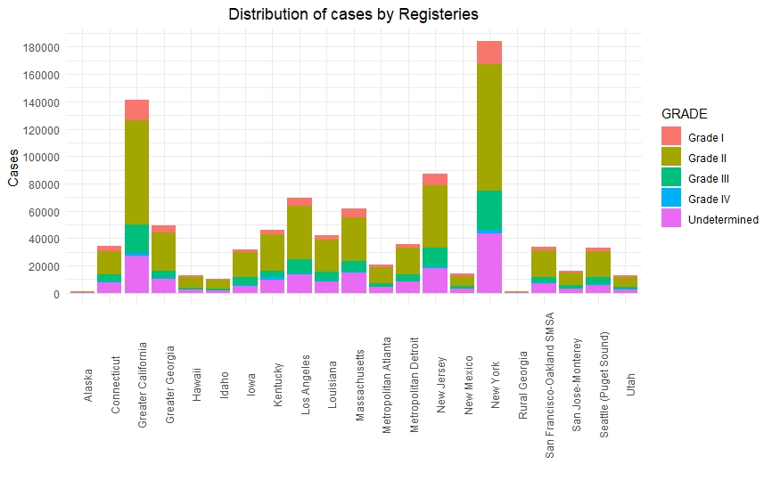
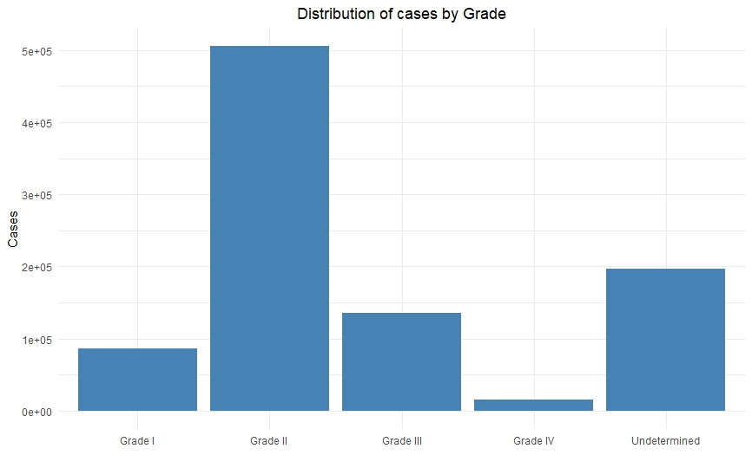
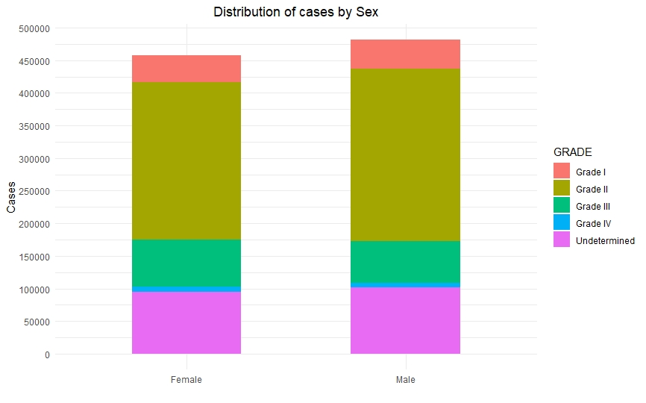
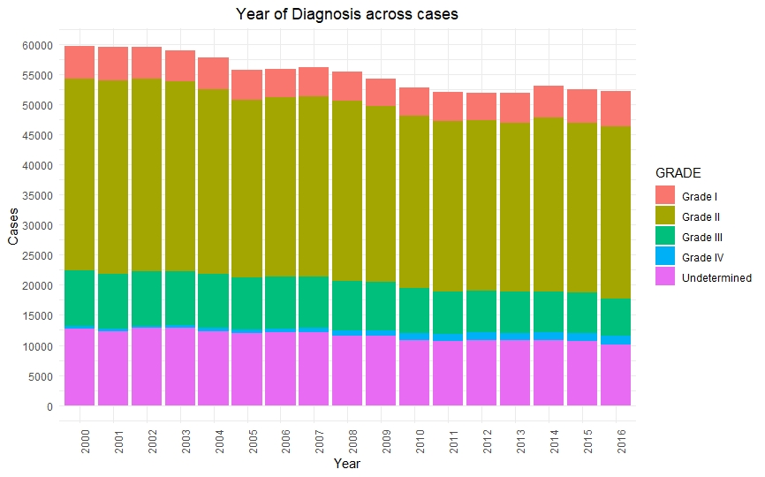
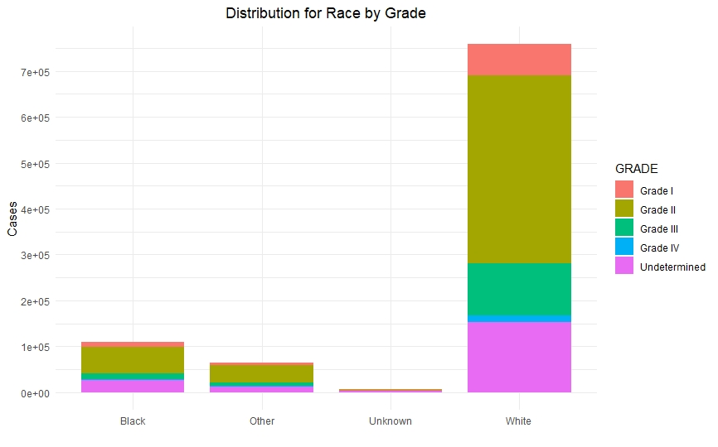
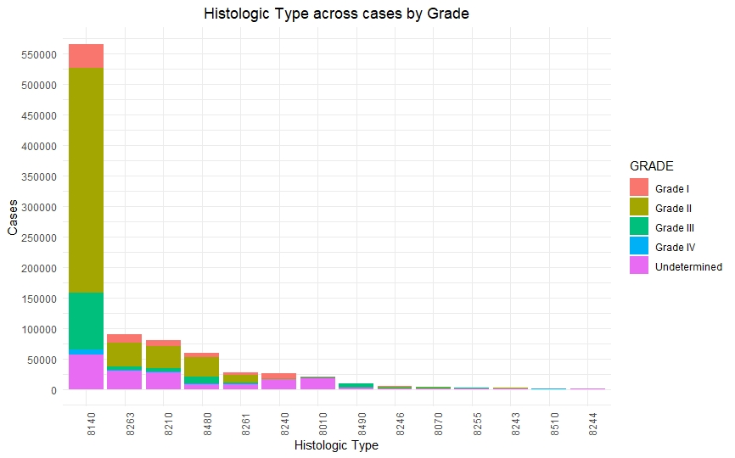
Data Exploration

Slide 6
Steps to Preprocess Data
Data Quality Issues – we worked on data quality issues include noise, outliers, missing values, and duplicate data etc.
Sampling – we conducted weighted sampling (stratified sampling) to facilitate data reduction for exploratory data analysis and scaling up algorithms to big data applications and quantifying uncertainties due to varying data distributions.
Transforming the data - we transformed our data , created dummy variables also binning our response variable i.e., Grade I, Grade II, Grade III, Grade IV into two categories 0 (combining Grade I & Grade II) and 1 (combining Grade III & Grade IV).

Slide 7
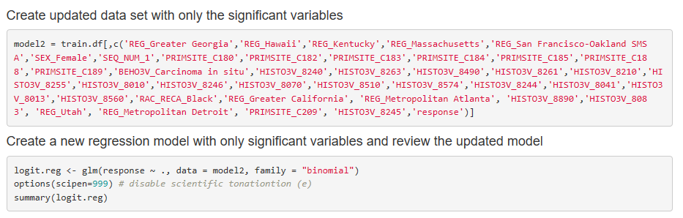
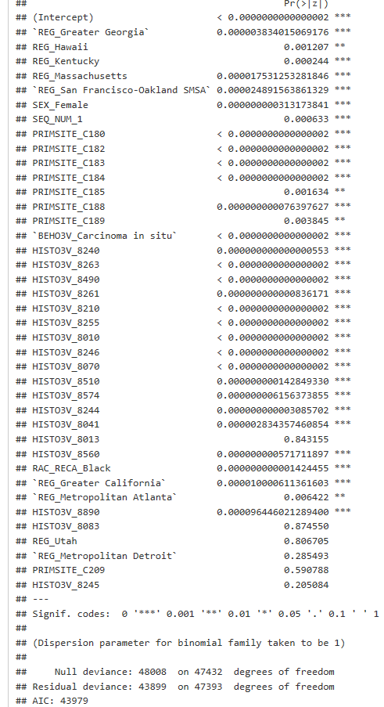
Logistic Regression
Final model
Final Output

Slide 8
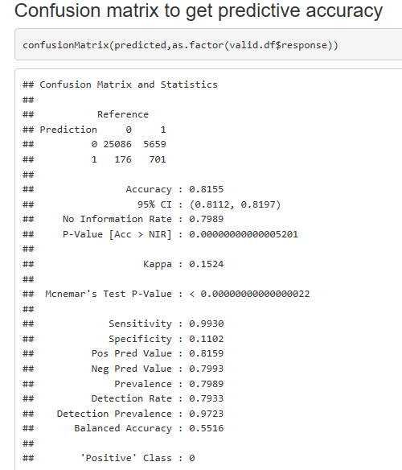
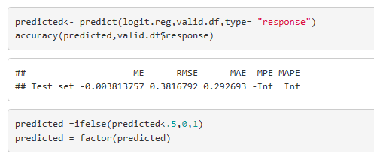
Evaluating Classification Performance
Our model is able to predict 81% of the validation data correctly.

Slide 9
Bias-variance tradeoff
Overall accuracy can be misleading
If we can get 74% accuracy but it ignores a class value that is represented by 30% of the data, is that ok?
Tree-based ensemble models tend to reduce the variance
Overfitting issues
The cross-validation estimator is nearly unbiased
The bias will tend to be pessimistic (that is, overestimate the error), which is good

Slide 10
LGBM, XGBOOST
Overall accuracy can be misleading
If we can get 74% accuracy but it ignores a class value that is represented by 30% of the data, is that ok?
Tree-based ensemble models tend to reduce the variance
Overfitting issues
The cross-validation estimator is nearly unbiased
The bias will tend to be pessimistic (that is, overestimate the error), which is good

Slide 11
Lift/Decile-wise Charts

Slide 12
Insights

Slide 13
Reference
Stat software citation: Surveillance Research Program, National Cancer Institute SEER*Stat software (seer.cancer.gov/seerstat) version 8.3.4.
SEER data citation: Database name=Incidence - SEER 18 Regs Research Data + Hurricane Katrina Impacted Louisiana Cases, Nov 2016 Sub (1973-2016 varying) - Linked To County Attributes - Total U.S., 1969-2015 Counties.

